Slide 1
Group no. 11 | group Name: Dhi Neural Network
A neural network that can understand
"hand-written digits!"

Slide 2
INTRODUCTION
In the early 1940's neurophysiologist Warren McCulloch and mathematician Walter Pitts, discovered the fine working and collaboration in how neurons of the brain might work.
As computing evolved, Nathanial Rochester from the IBM research laboratories proposed and hypothetical model of neural network.
Since, 1980’s the recognition of handwritten-digits have been aroused.
Decisively, in 1990’s the neural network were back astonishing the imagination of world.

Slide 3
Introduction
The mainstreaming of recognition transpire due to practices such as postal mail sorting, converting numeric entries of hand written forms, processing bank cheque amounts and so forth.
Furthermore, the challenges unfolded while approaching to solve are the digits are not always oof same size, orientations, thickness and relative positions respect to coordinates.
Our ambition is to implement an effective algorithm to solve aforementioned problem using linear algebra.

Slide 4
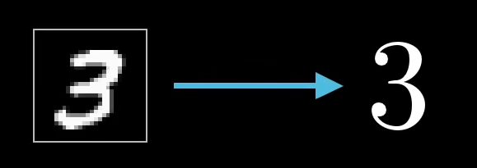
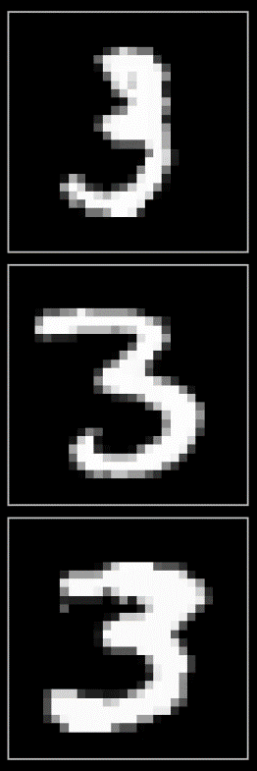



PROBLEM STATMENT
The only way !?
How ?
How Any Program Can Understand The Hand Written Digits ?

Slide 5
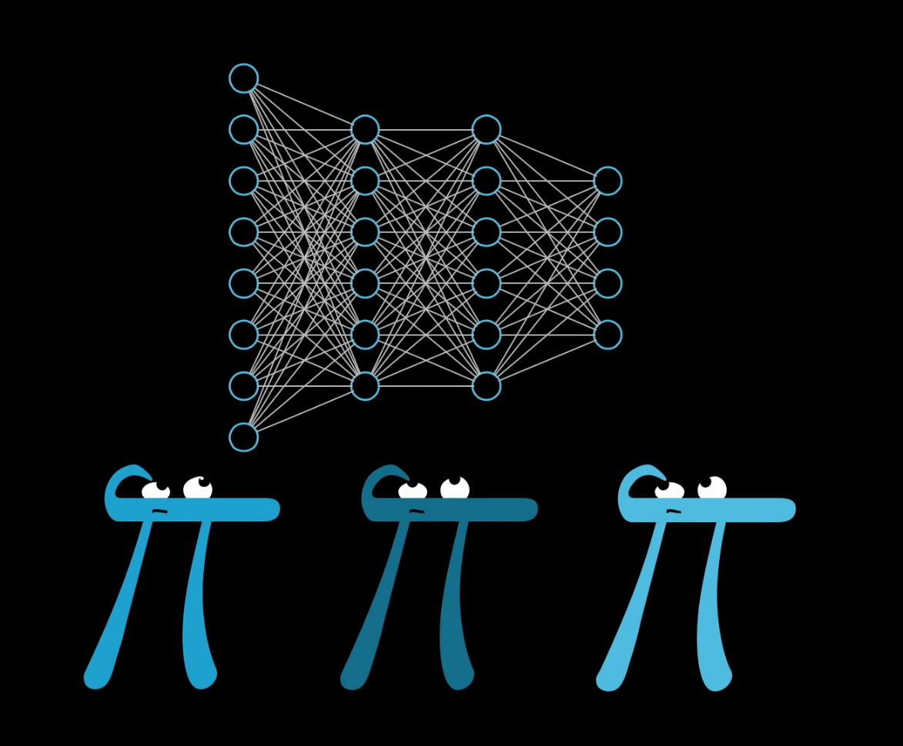
RESULTS

Slide 6
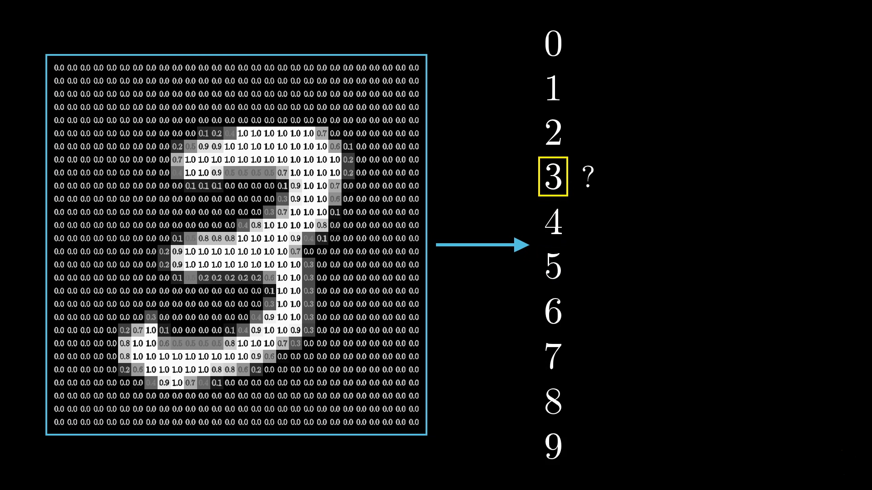
Our System
Input
As a grid ( 2D Array ) of pixels with Grey values
Output

Slide 7
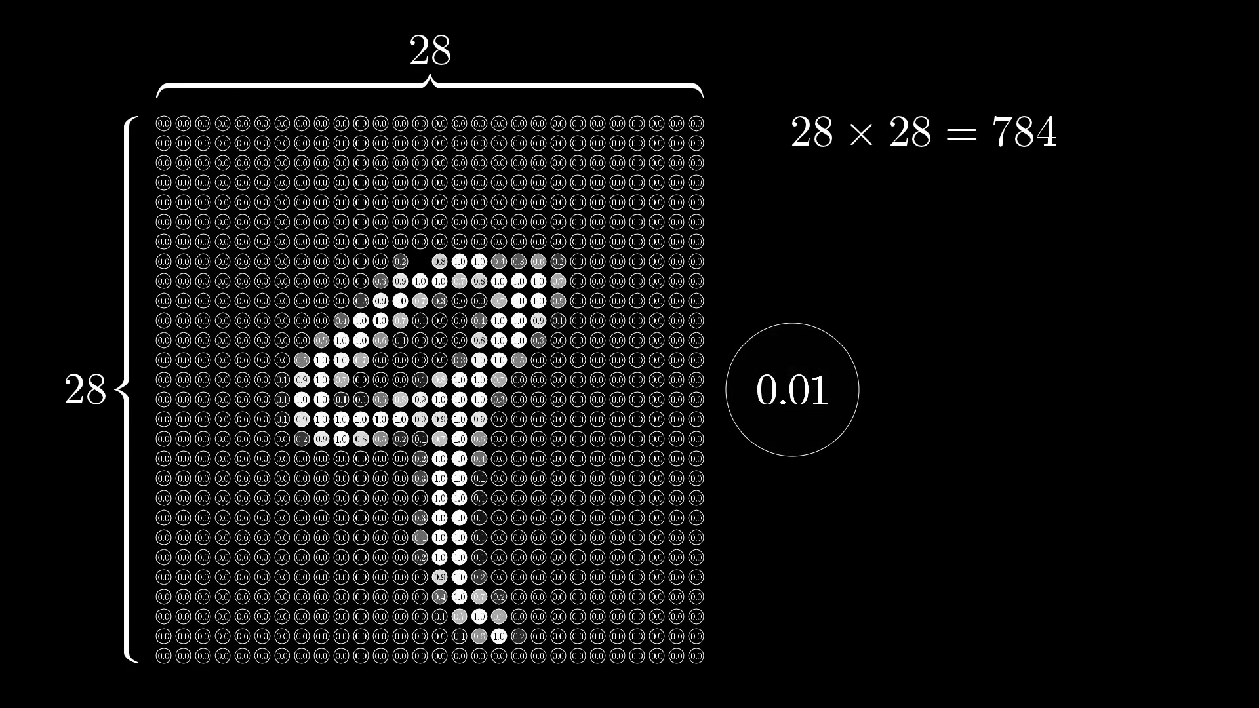
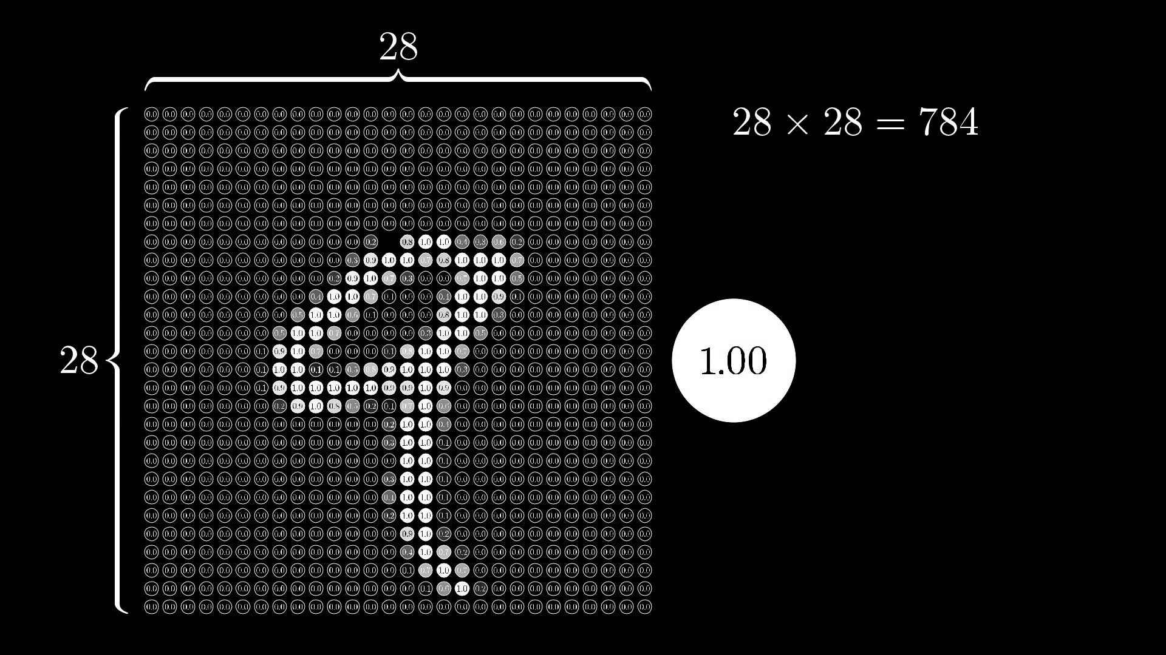
Total pixels
Node
Activation of a node

Slide 8
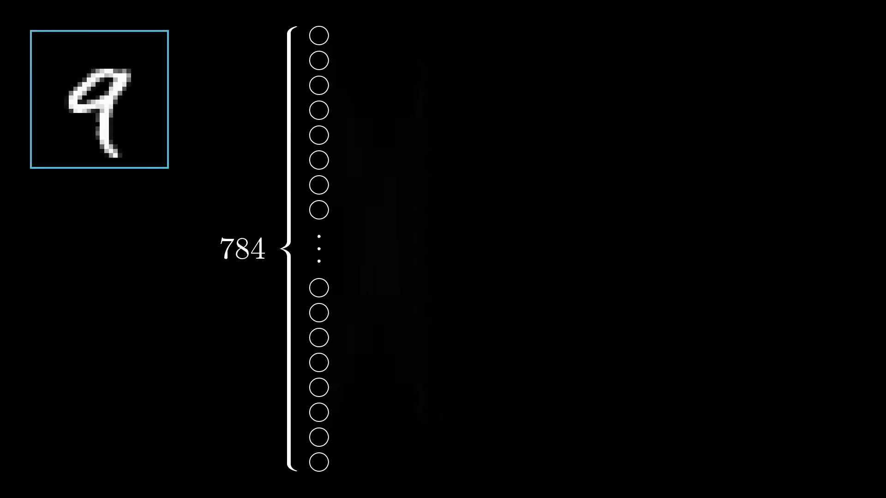
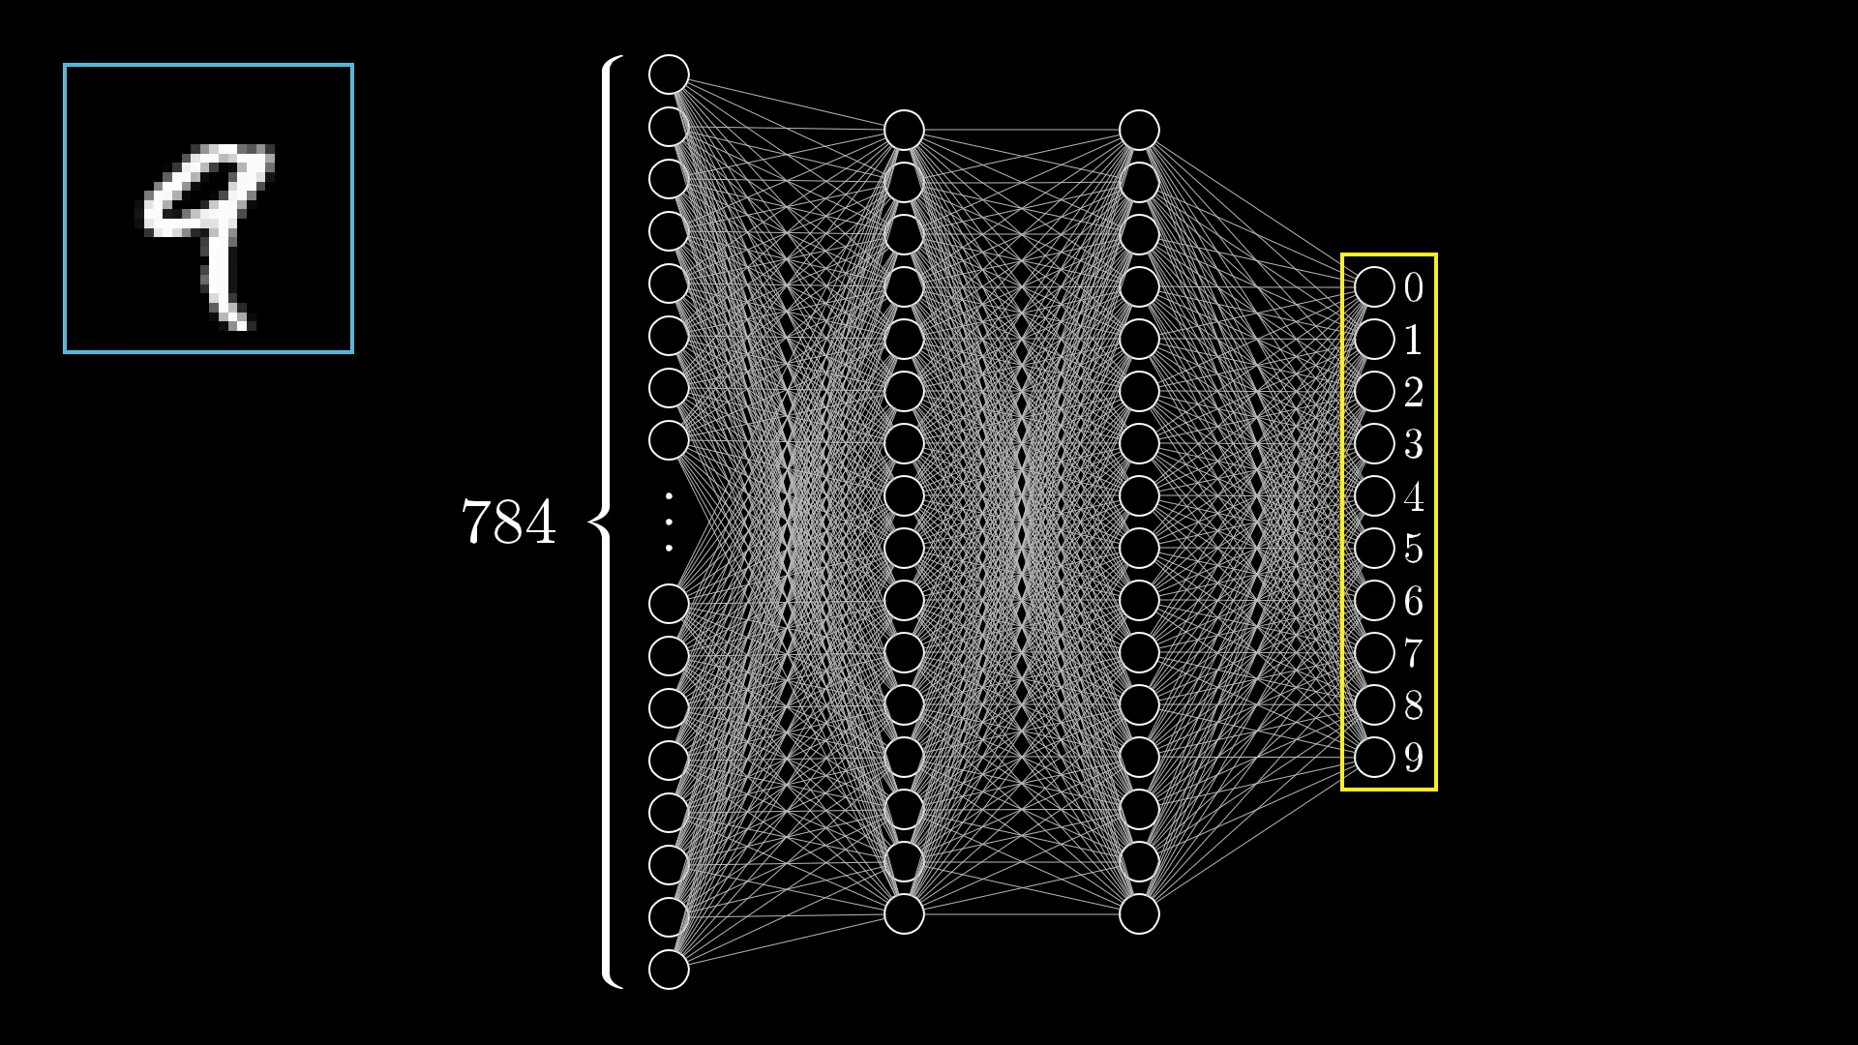
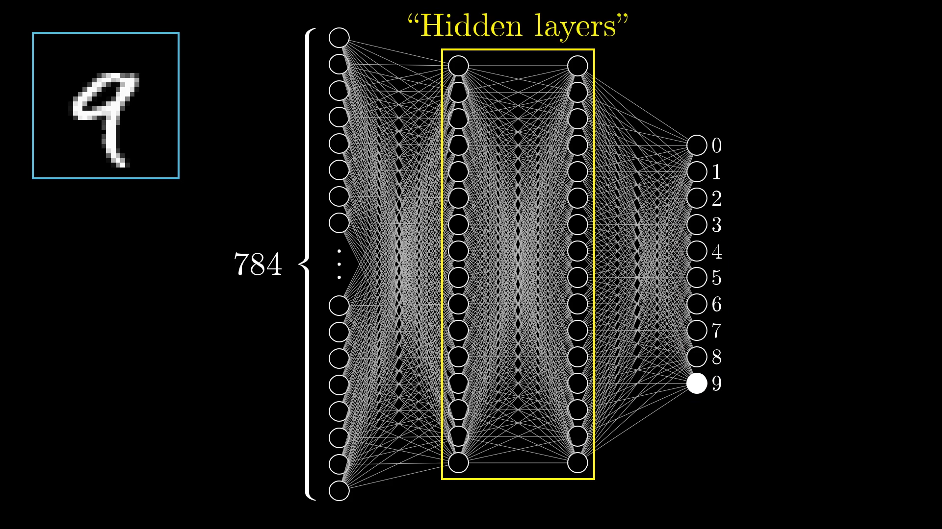

Slide 9
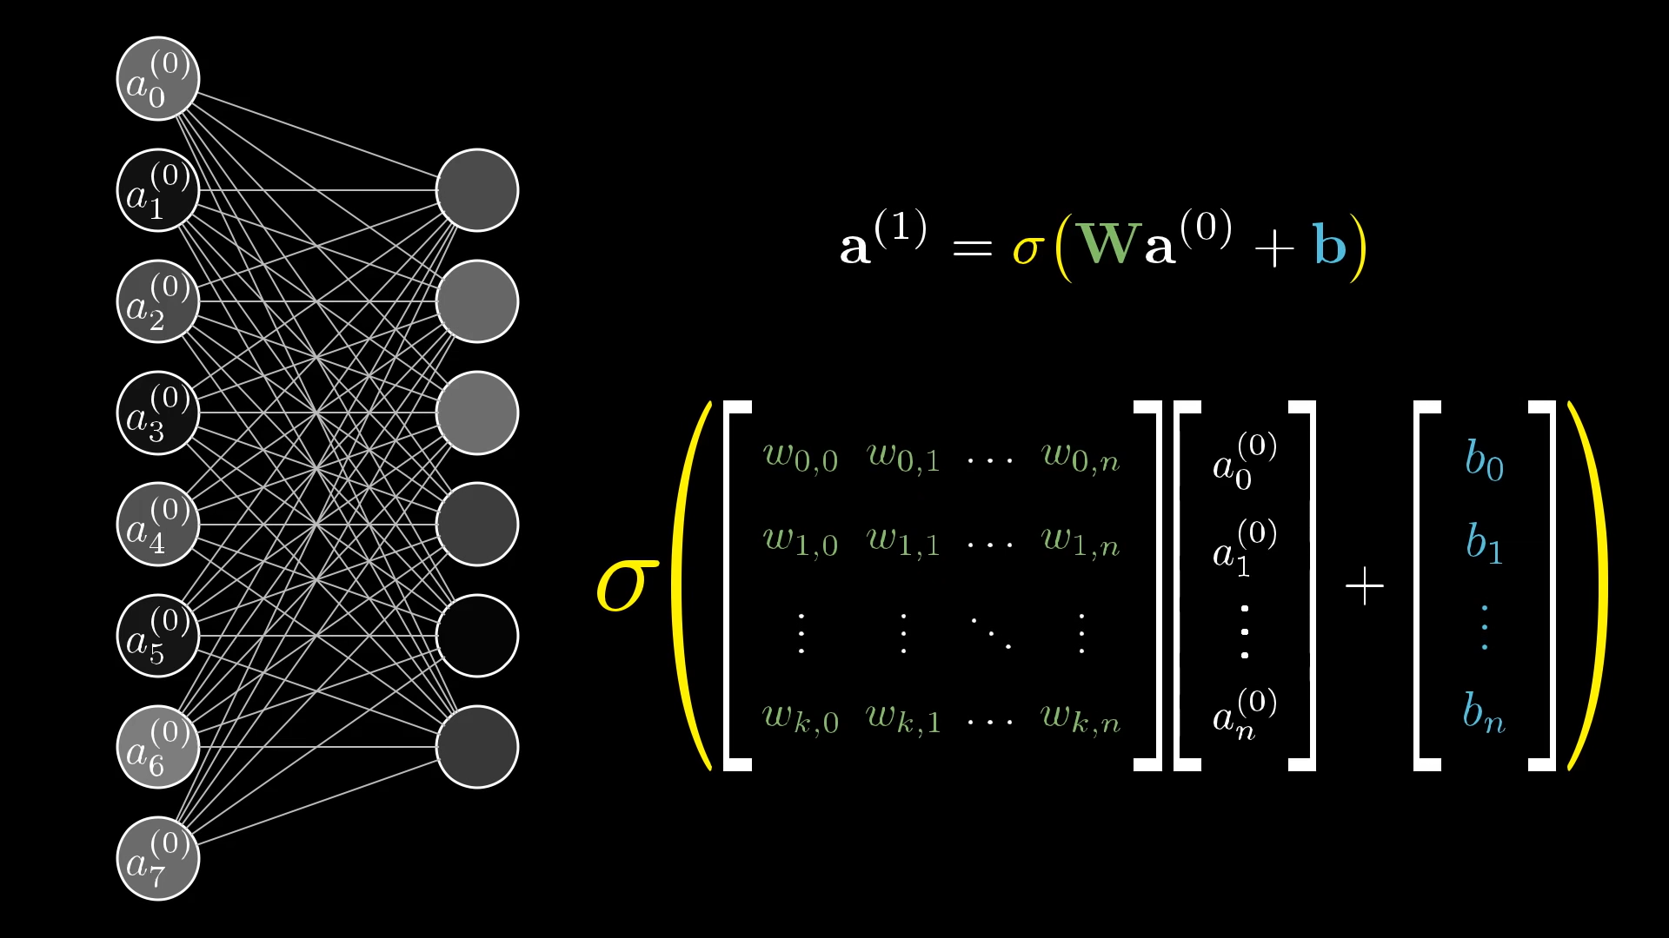
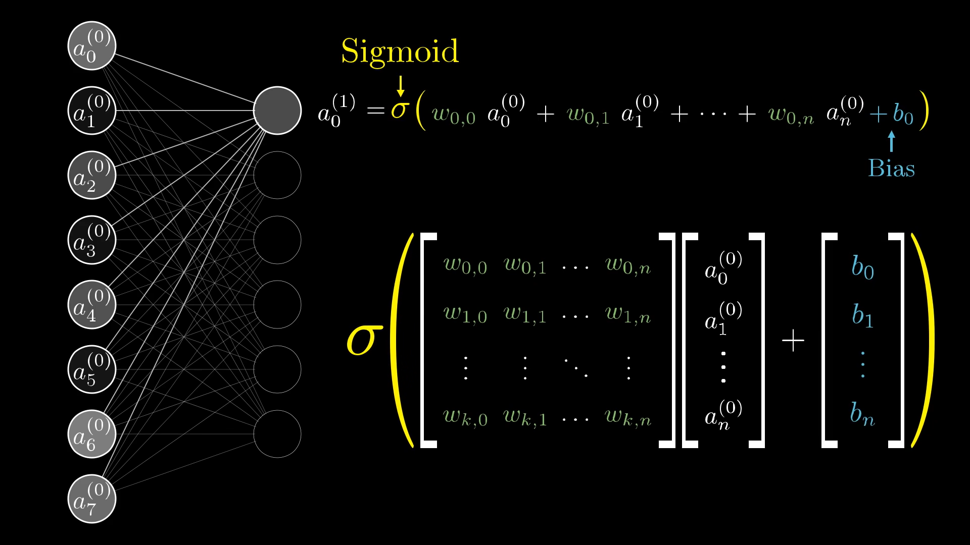
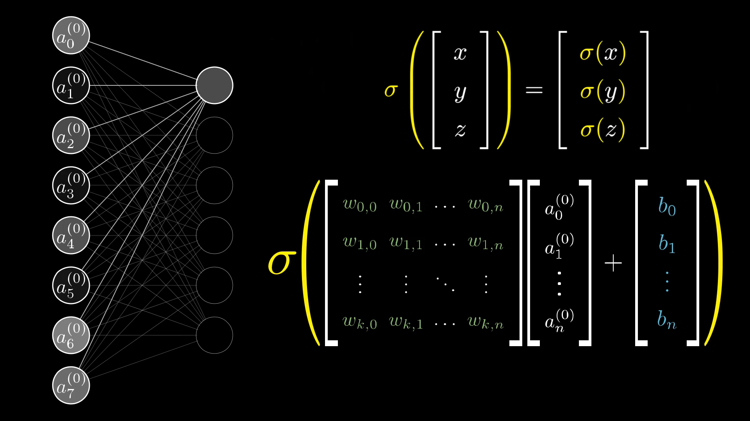
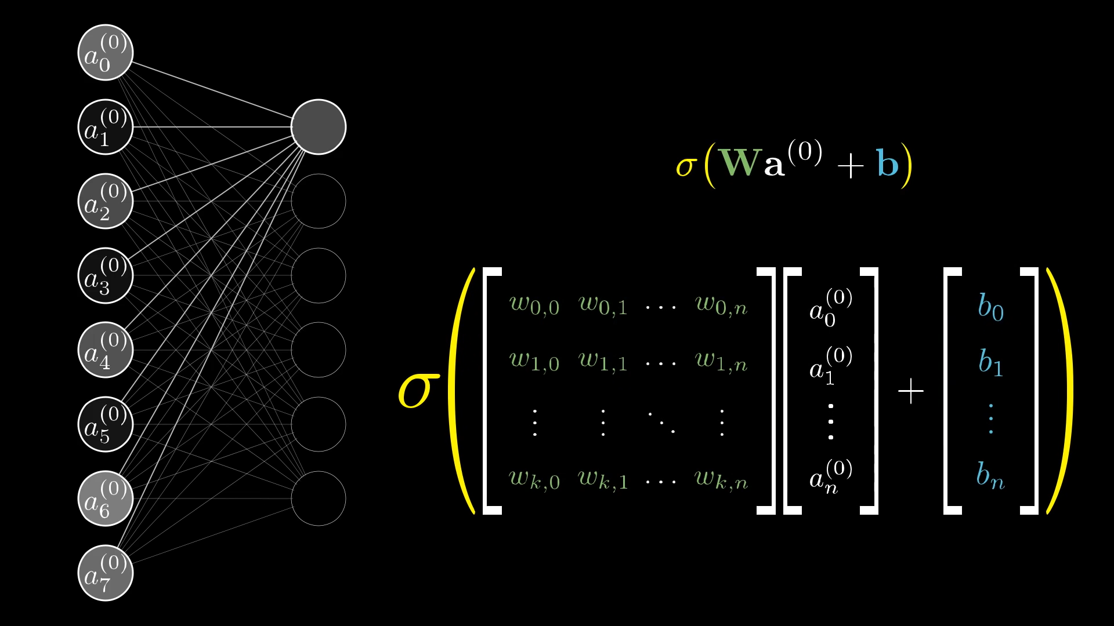

Slide 10
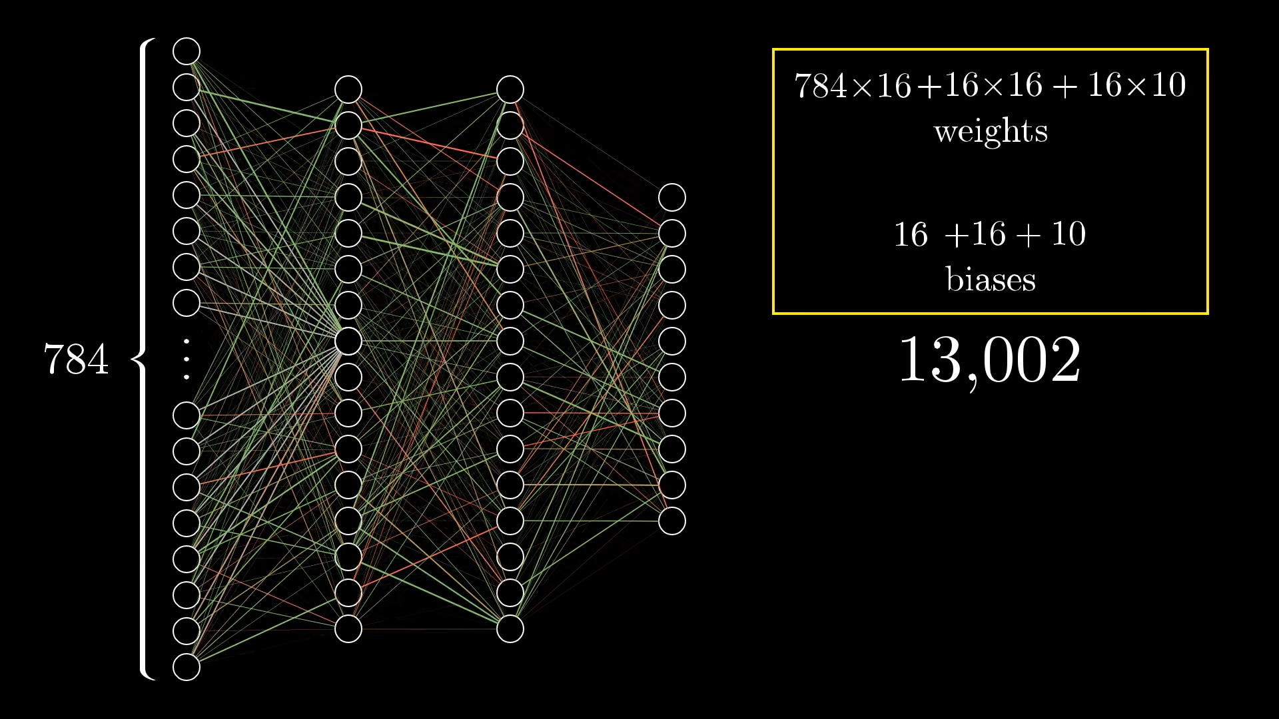
If we can choose right values of all these 13,002 weights and biases then we will able to recognize digits accurately !!!

Slide 11
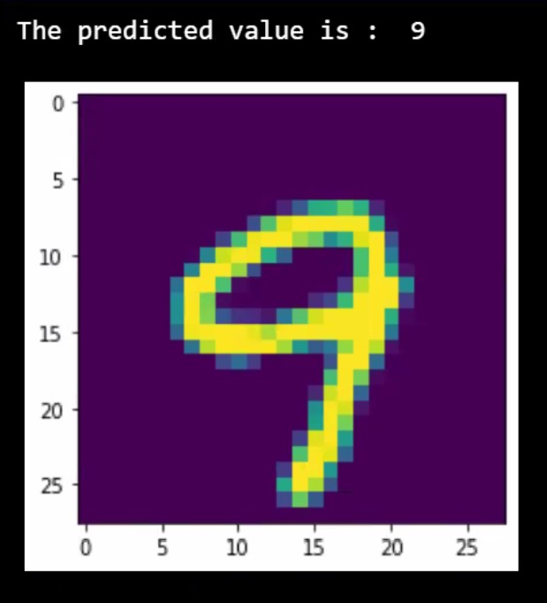
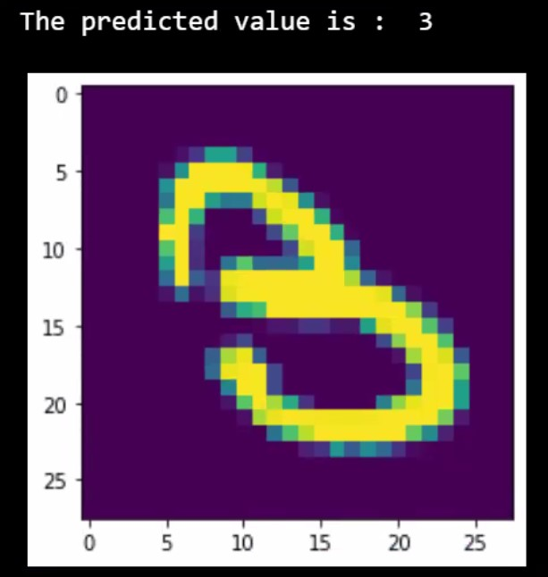
Prediction from code

Slide 12
Conclusions
Implementing TensorFlow and Keras Machine Learning and Deep Learning library we deduced the result of recognizing the hand written digits,.
Furthermore, we implemented each image as an 28 X 28 pixel and implemented them using the mathematical theorems.
The results generated for given inputs shos the digits recognized by the mathematical model.

Slide 13
references
Yegnanarayana, B. (2009c). ARTIFICIAL NEURAL NETWORKS. PHI Learning.
Pawlicki, Dan-Shyang Lee, Hull and Srihari, "Neural network models and their application to handwritten digit recognition," IEEE 1988 International Conference on Neural Networks, 1988, pp. 63-70 vol.2, doi: 10.1109/ICNN.1988.23913.
YouTube references (Image references):
https://youtube.com/playlist?list=PLZHQObOWTQDNU6R1_67000Dx_ZCJB-3pi
https://youtu.be/ER2It2mIagI
Websites:
Neural Networks - History (stanford.edu)

Slide 14
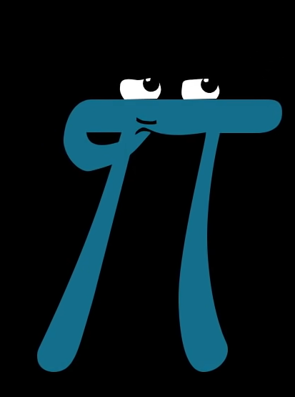
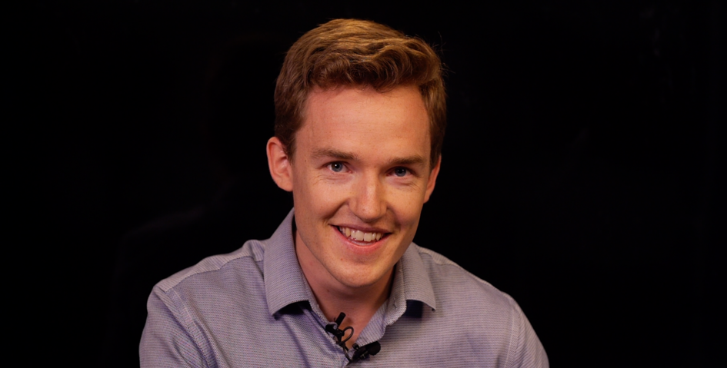
Acknowledgment
Grant Sanderson
https://www.3blue1brown.com/

Slide 15
Contributions
Vimoksh Bhavsar - Introduction, Reproduced Work.
Ruchit Ghodasara – Conclusions, Reproduce work.
Dhruvam Bhalodiya – Problem Statements, plan of action.

Slide 16
Roles of members
Vimoksh Bhavsar – Worked on generating and modeling the PPT’s and code models.
Ruchit Ghodasara – Generated the code results and worked on the Reports.
Dhruvam Bhalodiya – Worked on mathematical formulas and models and other reports and codes.

Slide 17
Thank You

